Slide 1


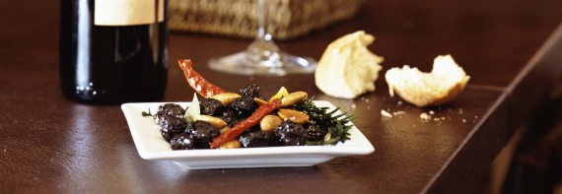
Dinner Etiquette
Presented by Liz Bradley, Bailey Lesniak, and Sierra Orfei

Slide 2
Agenda
The Importance of Dinner Etiquette
Enhancing Your Dinner Etiquette
Table Specific Manners
The Art of Table Conversation

Slide 3

The Importance of Dinner Etiquette

Slide 4
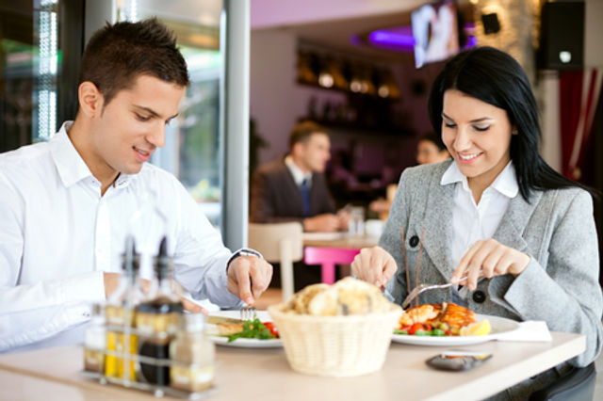
Why is Dinner Etiquette Important?
Dining etiquette is an essential ingredient of a first impression that is often neglected
Employers want to observe your conduct during meals and social situations, particularly for jobs requiring a certain demeanor with clients and superiors
Your table manners and behavior are an opportunity to make a good impression
The way you act at dinner may give others insight into your personality and level of professionalism
If dining etiquette is not understood, we may spend time at the table worrying about which fork we should use, or if we are reaching for the right glass, instead of paying attention to the conversations and people around us
Notes:
Most people focus on their tone of voice, body language, and dress when they are trying to make a good first impression, however, dining etiquette is one essential ingredient that often gets neglected.

Slide 5
Pros of Adopting Dinner Etiquette
Thorough knowledge of dining etiquette can give you an edge over others
Assuming that you are already good at your job, practicing proper dining etiquette can you put you at a significant advantage over others
Good dining etiquette can:
  Increase your chance of getting consumer/customer interest in your business
  Create a great impression
  Build personal rapport
  Encourage the client/host to listen more closely to you

Slide 6
Cons of Not Adopting Dinner Etiquette
Failing to recognize the importance of dining etiquette is likely to reduce your chances of success
It can be argued that in some corporate sectors, your dining etiquette is more important than your field experience
Drawbacks of not paying attention to this skill include:
  Your professional potential goes unrecognized
  You do not create your desired impact
  You do not get invited to business events
  You struggle to build rapport with clients and business contacts
  Your potential for professional growth is compromised

Slide 7

Enhancing Your Dining Etiquette

Slide 8
Carry Yourself According to the Venue
At any business or corporate event, your appearance and the clothes you wear are the first things other people will notice
Different dining occasions will inevitably have different dress codes and you need to adhere to these very carefully
It is important to ensure that you always follow the dress code according to the venue, time, and business theme

Slide 9
Greetings and Interactions
There is a distinct difference between a normal greeting and a greeting that invites another person to interact with you
A business lunch or dinner is a fantastic chance to build new connections, networks, and strong relationships

Slide 10


Table and Eating Manners
Always remember that the purpose of attending a corporate event, or business meeting, is not just to fill your stomach
The key points you need to bear in mind are:
  Your sitting posture
  Napkin and utensil etiquette
  Eating style
  Communication while eating
  Executive dining etiquette

Slide 11
General Good Manners to Practice
Respond to a dinner invitation within a week of receiving it
Never attempt to “out dress” the host/hostess
Be punctual – never arrive more than 10 minutes late
Always check with the host/hostess first about bringing a guest
When applicable, express appreciation to the host/hostess by presenting them with a small gift (flowers, chocolates, or champagne are fine examples)

Slide 12
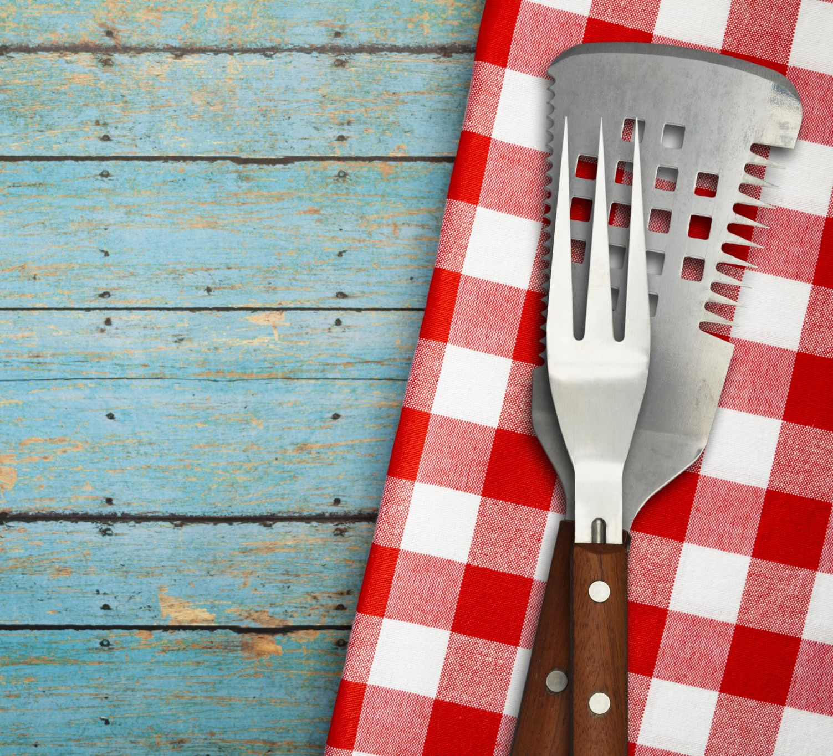
Table Specific Manners

Slide 13
Hosting a Dinner
It all begins with the table setting
  The host/hostess is “12 o’clock”
  When serving your guests, begin at “12 o’clock” of each table
  Food is served/passed around in a counterclockwise direction/to the left
    It is important that when several dishes are being passed at the same time, they all go in the same direction
  Beverages are served clockwise/to the right

Slide 14
A Sample Dinner Place Setting
To the left of the plate:
Napkin
Forks
Bread and butter plate
To the right of the plate:
Entrée knife
Spoons
Drinks

Slide 15
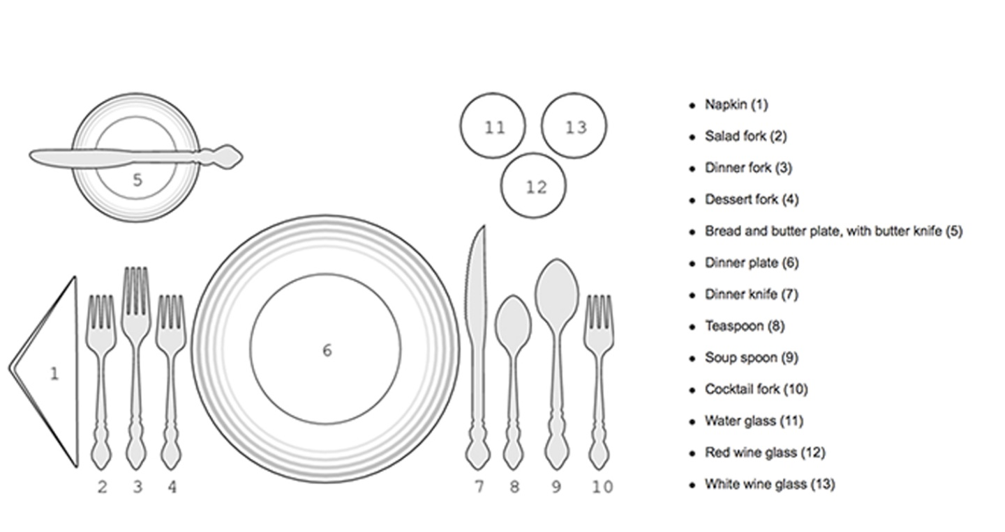
A Sample Dinner Place Setting

Slide 16
Table Manners: Dos
Once seated, unfold your napkin and place it on your lap for the entire meal to use occasionally for wiping lips and fingers
If for some reason you must get up from the table, place the napkin on the seat of the chair
Leave the napkin tidily on the place setting at the end of the dinner
Sit properly and straight in your chair and avoid placing your elbows on the table when eating
It is acceptable to prop your elbows on the table while conversing between courses
Wait until everyone has their food before you begin eating
When someone asks for the salt, pass it along with the pepper – they travel in pairs!
Chew with your mouth closed
Hold the knife and fork with the handles in the palm of the hand, forefinger on top, and thumb underneath
When finished eating, place the utensils side by side in the center of the plate
It is polite to eat a small amount of food if it is not to your liking
At the very least, cut it up a little and move it around the plate
Always make a point of thanking the host/hostess for their hospitality before leaving
When determining which utensil to use first, follow the "outside-in" rule. Use utensils on the outside first and work your way inward.

Slide 17
Table Manners: Don’ts
Never begin eating before a signal from the host/hostess to do so
Do not stretch across the table crossing other guests to reach food, wine, or condiments
Instead, ask a guest sitting close to you to pass the item to you
Refrain from offering criticism about a meal
If you are unable to pay any compliments, remain silent on the subject
Unless toothpicks are provided, avoid picking teeth or licking fingers during a meal
As you can image, this can be very unattractive
Smartphones should not be an accessory at the dinner table
Set them to silent or vibrate
Guests are encouraged to interact with other guests and the host/hostess
Make any calls away from the table and keep them brief

Slide 18
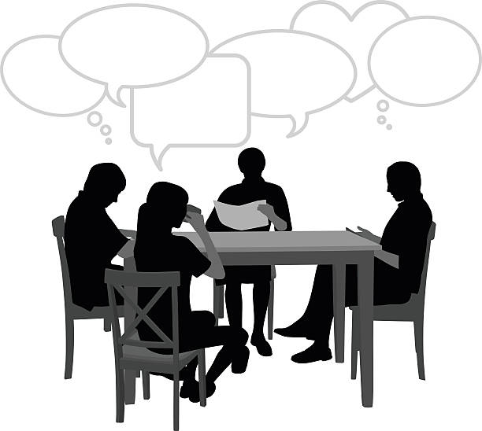
The Art of Table Conversation

Slide 19
The Basis of Good Conversation
Courtesy
  Be considerate of the feelings of others
  Do your part to "keep the conversation rolling"
  Speak in soft, pleasant, well-modulated tone
Good manners in conversation
  Do not interrupt the person speaking
  Maintain eye contact
  Do not monopolize the conversation
Having a sincere interest in the conversation
  Give compliments
  Listen attentively
  Remember names

Slide 20
Making Introductions
Eat and Greet​!
  Begin with greeting everyone at the table ​
  Introduce guests or new friends to others
  Each individual should say their name and where they are from or a snippet about themself
  Always try to extend a hand for a handshake when being introduced to someone

Slide 21
Conversation Starters
    Compliments are nice as are open ended questions
    " What's new in your world? " or " How did you spend your day? "
    Safe and Neutral Topics
      Travel and Vacations
      Hobbies and Interests
      Current Events
      Food and Drink

Slide 22
Tips on Joining a Conversation
Show a genuine interest
Make eye contact
Make a contribution when appropriate
Ask for more information on the topic
Mention a shared experience
Ask an opinion
Comment on something pleasant

Slide 23
Leaving a Conversation
Be respectful when trying to exit a conversation
  It is rude to let your eyes wander around the room while conversing with others
  While involved in the conversation, be an engaged listener and active participant, even if you've been itching to leave the conversation
Capitalize on a lull in conversation
Create the end to your conversation in a polite manner
Ensure not to hold other guest guests "captive" in a conversation
Notes:
Lull - "It's been so nice catching up with you; I'm going to refresh my drink/thank the hostess/try one of those delicious-looking cupcakes"
End to Convo - "It's been so lobely chatting with you, but I've just realized I have yet to say hello to the host" or "I'm so sorry to stop you, but I'm afraid I was on my out the door to get home to the babysitter. I've enjoyed catching up, and hope I'll see you again soon"
Not hold people captive - "I know you've got to make the rounds, but it's been great talking with you" - people will be appreciative of you acknowledgement of their time

Slide 24
Additional Considerations
Topics to Avoid
Politics
Religion
Money & Salaries
Personal Problems
Controversial Current Events
Be Mindful of Body Language
Avoid crossing arms or looking disinterested
Your facial expressions should convey attentiveness

Slide 25
In Summary:
Mastering the art of table conversation is key to leaving a positive impression
Remember to stick to neutral topics and avoid controversial subjects
Be engaged and actively listen to others

Slide 26
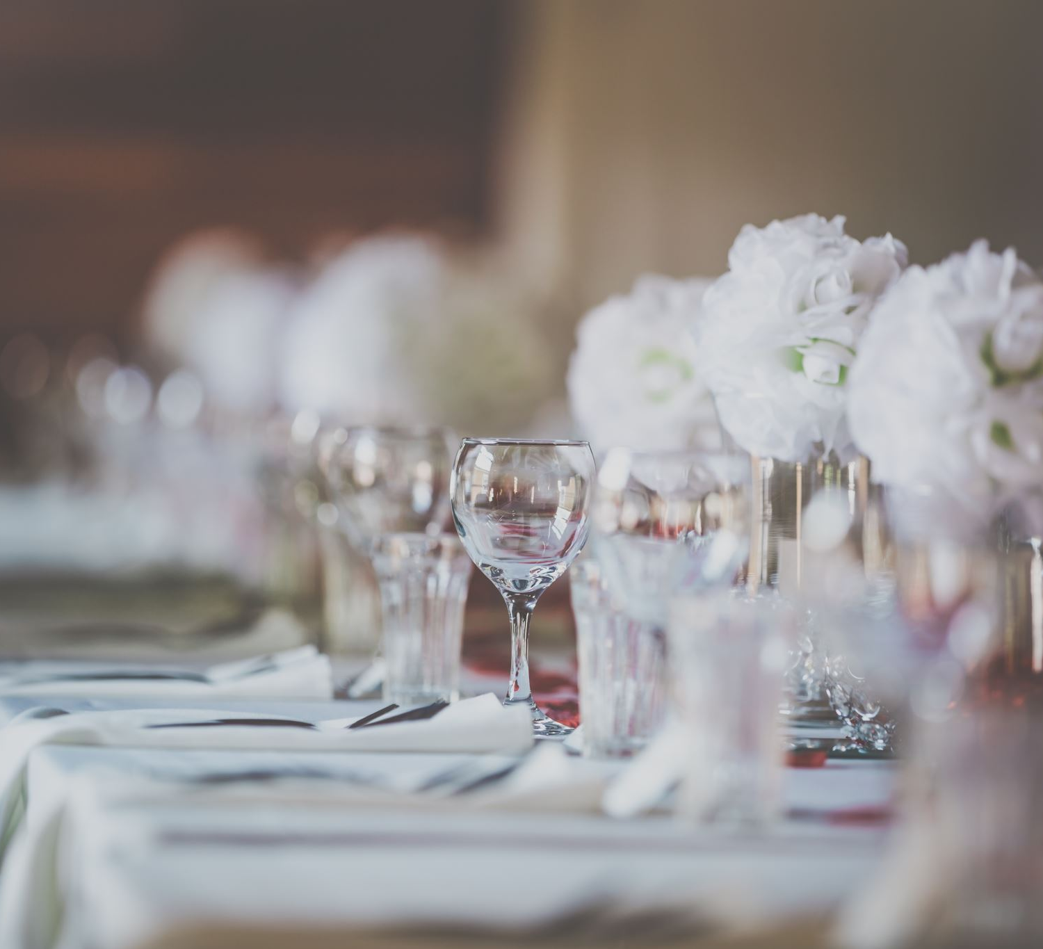
Final Thought
"The dinner table is the center for the teaching and practicing not just of table manners but of conversation, consideration, tolerance, family feeling, and just about all the other accomplishments of polite society except the minuet." - Judith Martin, "Miss Manners"

Slide 27
References
Lally, Courtney. “The Importance of Dining Etiquette - #NLPLab.” LinkedIn, 13 Nov. 2019, www.linkedin.com/pulse/importance-dining-etiquette-nlplab-courtney-lally/.
Sykes, Philip. “Enhance Your Dining Etiquette for Professional Success.” LinkedIn, 20 Nov. 2020, www.linkedin.com/pulse/enhance-your-dining-etiquette-professional-success-philip-sykes-1c/.
Kent State University. “Dining Etiquette | Kent State University.” www.kent.edu/career/dining-etiquette.
“Table Manners during the Meal: Part 1 - Buckeye OnPACE.” (Accessed: 10 October 2023).
"Table Manners during the Meal: Part 2 - Buckeye OnPACE.” (Accessed: 10 October 2023).

Slide 28

Questions ?

